Slide 1
Forecasting
Supply Chain Management, Chapter 7
Christopher J Chen
Department of Operations and Decision Technologies

Slide 2
Adaptive Forecasting

Slide 3
Adaptive Forecasting
Initialize
Estimate level, trend, and seasonal factors
Forecast
Use the level, trend, and seasonal factors to forecast future demand
Observe
Observe new demand
Adapt
Modify estimates of level, trend, and seasonal factors using latest observation
Record the error from the forecast

Slide 4
Adaptive Forecasting
 | Level | Trend | Seasonality
Moving Average | ✓ | ✗ | ✗
Simple Exponential Smoothing | ✓ | ✗ | ✗
Holt's Model | ✓ | ✓ | ✗
Winter's Model | ✓ | ✓ | ✓

Slide 5
Adaptive Forecasting: Moving Average of $N$ periods
Initialize
Level = average of the demand in the last $N$ periods
Level = average of the demand in the last 𝑁 periods
Forecast
Forecast for next period = level
Forecast for two periods from now = level, …
Observe
Observe the actual demand
Adapt
Updated level = average of the demand in the last $N$ periods.
Updated level = average of the demand in the last 𝑁 periods.

Slide 6
Moving Average
Example 5
The following table shows the demand for penne pasta (measured in boxes) in a grocery store over the last five weeks. The grocery store uses a four-period moving average to forecast the future demand for pasta.
What is the forecast for week 6 demand? For week 7?
Initialize: Estimate the level --- (450+250+500+400) / 4 = 400
Current forecast for demand in week 6 = Level = 400
Current forecast for demand in week 7 = Level = 400
Week | Demand
1 | 300
2 | 450
3 | 250
4 | 500
5 | 400

Slide 7
Moving Average
Example 5
It turns out that the week 6 demand was 250.
What is the forecast for week 7 demand?
Week | Demand
1 | 300
2 | 450
3 | 250
4 | 500
5 | 400
6 | 250
Notes:
7 300 8 450 9 450 10 310 11 400 12 300

Slide 8
Adaptive Forecasting: Simple Exponential Smoothing
Initialize
Level = average of all previous demand observations
Forecast
Forecast for next period = level
Forecast for two periods from now = level, …
Observe
Observe the actual demand
Adapt
Updated level = $α×$ observed demand $+\left(1−α\right)×$ previous level
Updated level = 𝛼× observed demand +(1−𝛼)× previous level

Slide 9
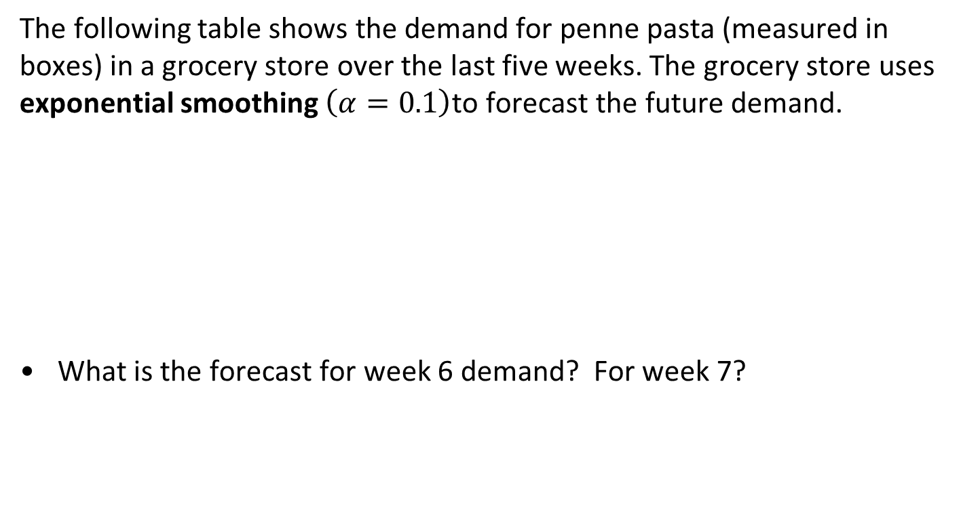
Simple Exponential Smoothing
Example 5
The following table shows the demand for penne pasta (measured in boxes) in a grocery store over the last five weeks. The grocery store uses exponential smoothing $\left(α=0.1\right)$to forecast the future demand.
What is the forecast for week 6 demand? For week 7?
Week | Demand
1 | 300
2 | 450
3 | 250
4 | 500
5 | 400

Slide 10
Simple Exponential Smoothing
Example 5
It turns out that the week 6 demand was 250.
What is the forecast for week 7 demand?
Week | Demand
1 | 300
2 | 450
3 | 250
4 | 500
5 | 400
6 | 250

Slide 11
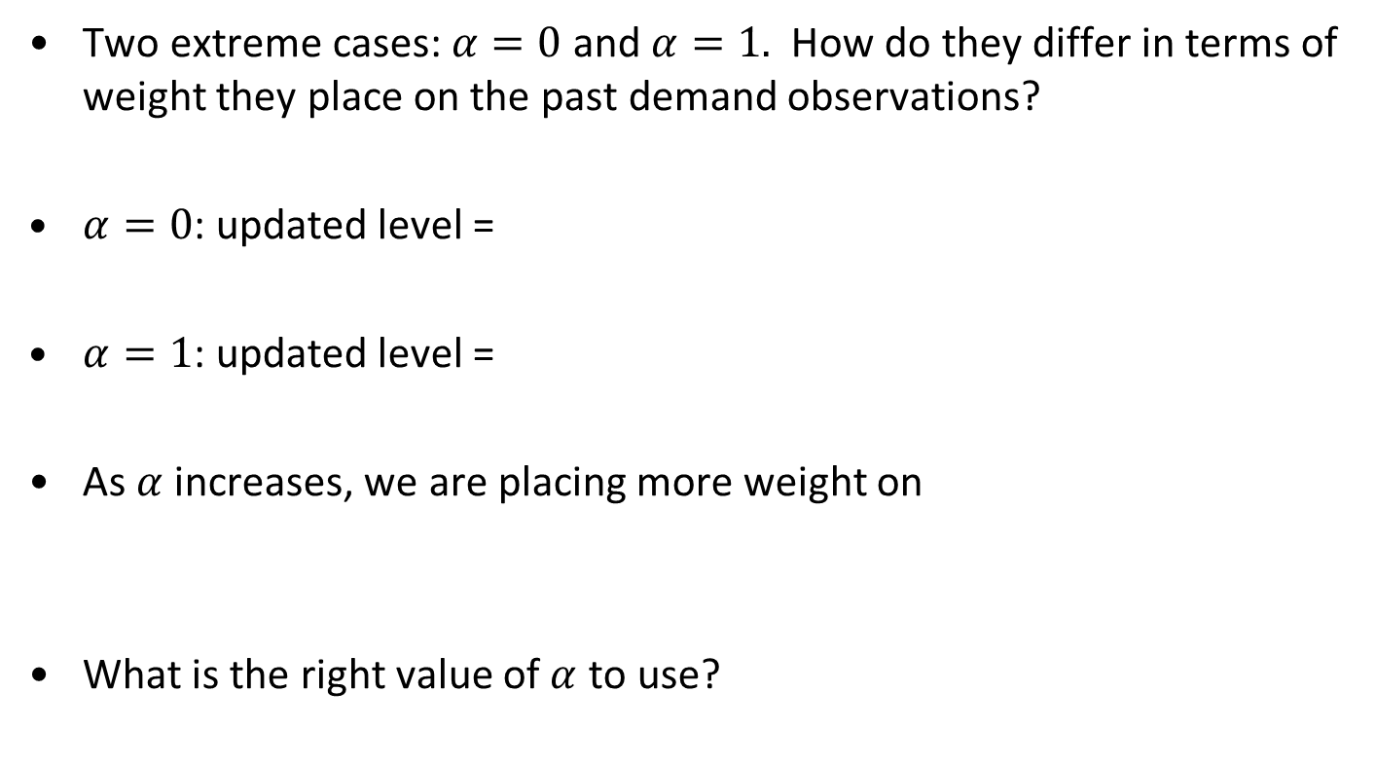
Simple Exponential Smoothing
Two extreme cases: $α=0$ and $α=1.$ How do they differ in terms of weight they place on the past demand observations?
$α=0$: updated level =
$α=1$: updated level =
As $α$ increases, we are placing more weight on
What is the right value of $α$ to use?

Slide 12
Adaptive Forecasting: Holt’s Model
Initialize
Level and trend: estimated using linear regression.
Forecast
Forecast for next period = level + trend
Forecast for two periods from now = level + $2×$ trend, …
Forecast for two periods from now = level + 2× trend, …
Observe
Observe the actual demand
Adapt
Updated level = $α×$ observed demand $+\left(1−α\right)×$ (previous level + previous trend)
Updated level = 𝛼× observed demand +(1−𝛼)× (previous level + previous trend)
Updated trend = $β×$(updated level – previous level) + $\left(1−β\right)×$ previous trend
Updated trend = 𝛽× (updated level – previous level) + (1−𝛽)× previous trend

Slide 13
Adaptive Forecasting: Holt’s Model
Example 6
GetSmart is a new phone that has been on the market for a few months. A retailer uses Holt’s model with α = 0.1 and β = 0.2 to forecast future demand. Suppose that the current estimates of level and trend are 173 and 71, respectively.
What is the current forecast for next month’s demand? How about the current forecast for the demand in the month after?
Suppose next month’s demand turns out to be 280. Update the level and trend estimates.
After updating, what is the forecast for the next month’s demand?

Slide 14
Adaptive Forecasting: Winter’s Model
Initialize
Deseasonalize the data
Forecast
Forecast for next period = (level + trend) $×$ seasonal factor for next period
Forecast for next period = (level + trend) × seasonal factor for next period
Forecast for two periods from now = (level + $2×$ trend) $×$ seasonal factor for two periods from now…
Forecast for two periods from now = (level + 2× trend) × seasonal factor for two periods from now…
Observe
Observe the actual demand
Adapt
Updated level = $α×$ (observed demand / seasonal factor) $+\left(1−α\right)×$ (previous level + previous trend)
Updated level = 𝛼× (observed demand / seasonal factor) +(1−𝛼)× (previous level + previous trend)
Level and Trend: estimated using linear regression
Updated trend = $β×$(updated level – previous level) + $\left(1−β\right)×$ previous tend
Updated trend = 𝛽× (updated level – previous level) + (1−𝛽)× previous tend
Estimate the seasonal factor
Updated seasonal factor = $γ×$ (observed demand / new level) $+\left(1−γ\right)×$ previous value of seasonal factor
Updated seasonal factor = 𝛾× (observed demand / new level) +(1−𝛾)× previous value of seasonal factor

Slide 15
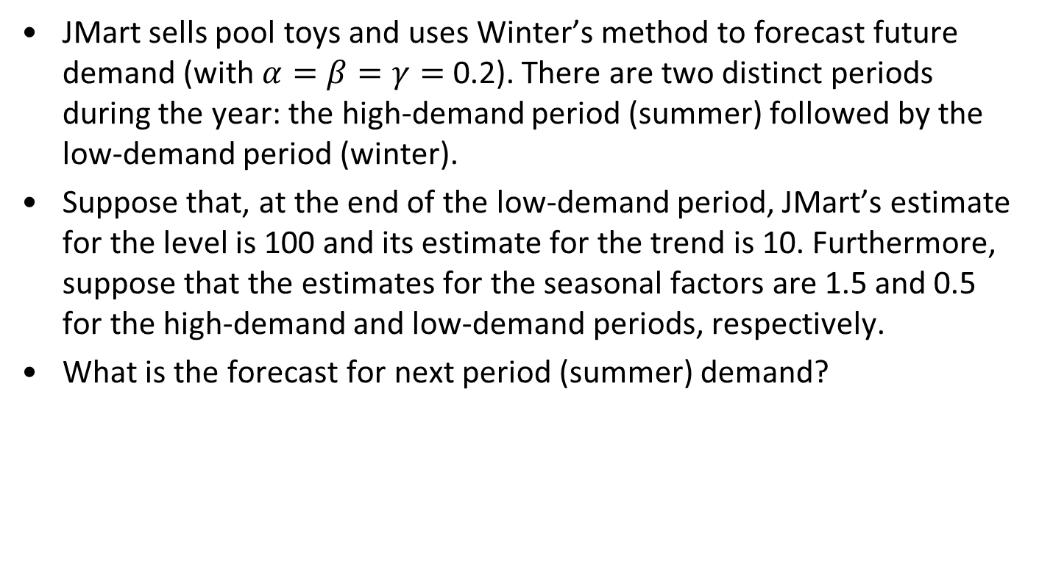
Adaptive Forecasting: Winter’s Model
Example 7
JMart sells pool toys and uses Winter’s method to forecast future demand (with $α=β=γ=$0.2). There are two distinct periods during the year: the high-demand period (summer) followed by the low-demand period (winter).
Suppose that, at the end of the low-demand period, JMart’s estimate for the level is 100 and its estimate for the trend is 10. Furthermore, suppose that the estimates for the seasonal factors are 1.5 and 0.5 for the high-demand and low-demand periods, respectively.
What is the forecast for next period (summer) demand?

Slide 16
Adaptive Forecasting: Winter’s Model
Example 7
Suppose the summer demand turns out to be 150. Update the estimates of level, trend, and seasonal factors.
After updating, what is the forecast for the demand in the next period (winter)? How about the forecast for next summer?

Slide 17
Using StatTools to automate adaptive forecasting
Warning: StatTools calculates the initial estimate of trend in adaptive forecasts slightly different from the textbook. Otherwise, everything is the same.
Note: for Winter’s method, StatTools requires data for more than double the number of seasons. Example: if there are 4 seasons, StatTools requires more than 8 data points.

Slide 18
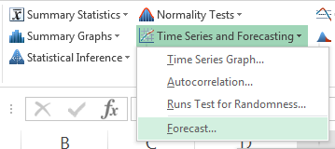
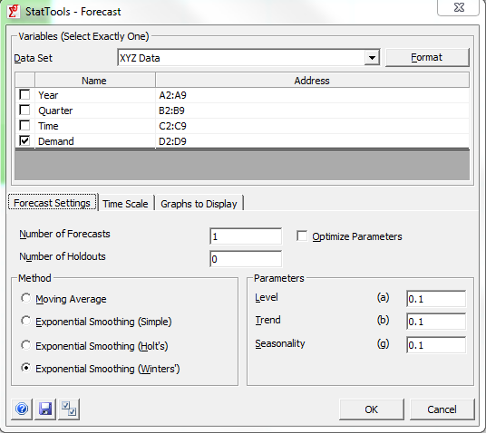
Using StatTools to automate adaptive forecasting
Use the “Forecast” tool
Select variables and forecasting method

Slide 19
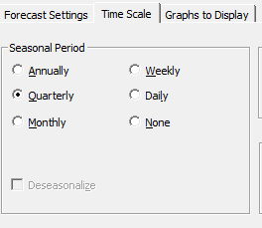
Using StatTools to automate adaptive forecasting
Select type of seasonality (if applicable). StatTools may try to do this for you but always check.

Slide 20
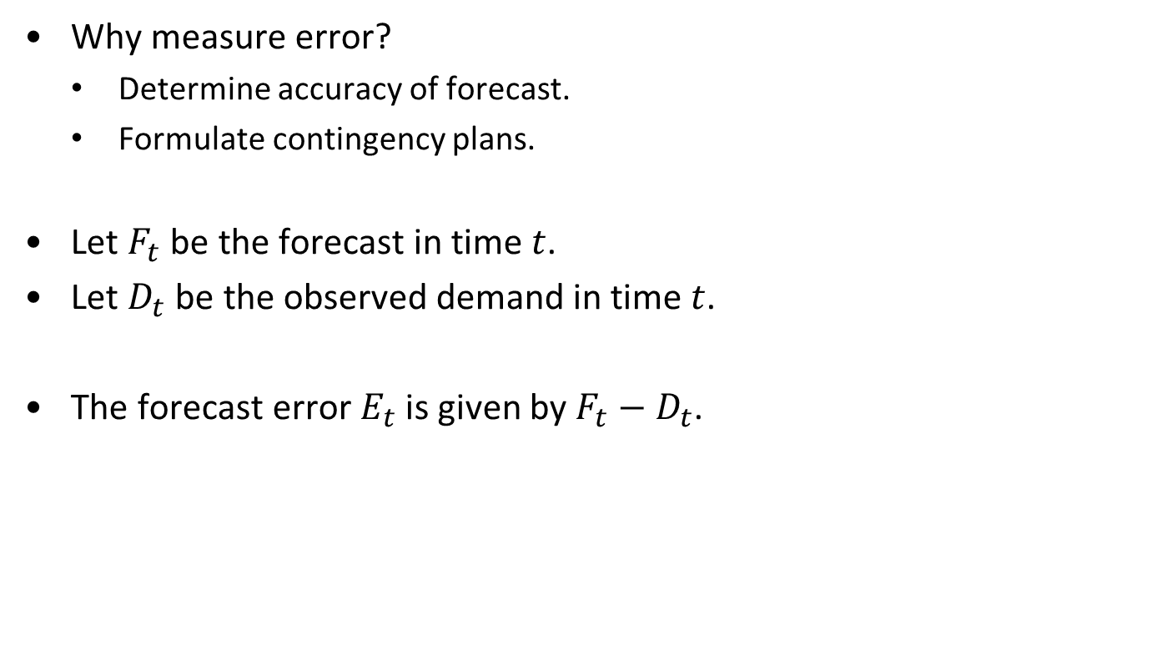
Measures of Forecast Error
Why measure error?
Determine accuracy of forecast.
Formulate contingency plans.
Let $F_{t}$ be the forecast in time $t$.
Let $D_{t}$ be the observed demand in time $t$.
The forecast error $E_{t}$ is given by $F_{t}−D_{t}$.

Slide 21
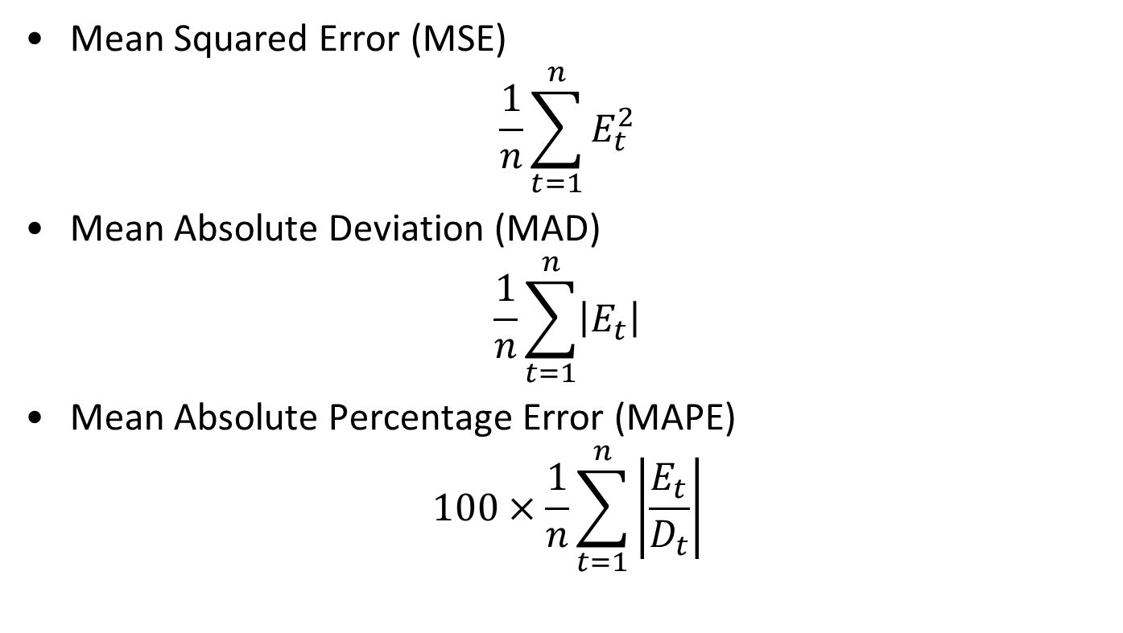
Measures of Forecast Error
Mean Squared Error (MSE)
$$\frac{1}{n}\sum_{t=1}^{n}{E_{t}^{2}}$$
Mean Absolute Deviation (MAD)
$$\frac{1}{n}\sum_{t=1}^{n}{\left|E_{t}\right|}$$
Mean Absolute Percentage Error (MAPE)
$$100×\frac{1}{n}\sum_{t=1}^{n}{\left|\frac{E_{t}}{D_{t}}\right|}$$

Slide 22
MSE vs MAD
Example MSE vs MAD
Suppose you have the following demand and two different forecasts. Calculate the MSE and MAD for each. Which forecast is better? Why?
Time | Demand | Forecast 1 | Forecast 2
1 | 27 | 37 | 47
2 | 63 | 53 | 63
3 | 25 | 15 | 25
4 | 26 | 36 | 46

Slide 23

Measures of Forecast Error
Mean Absolute Deviation (MAD)
$$\frac{1}{n}\sum_{t=1}^{n}{\left|E_{t}\right|}$$
Can be used to approximate the amount of variability in the data. Typically, the standard deviation of demand is about 1.25 x MAD

Slide 24
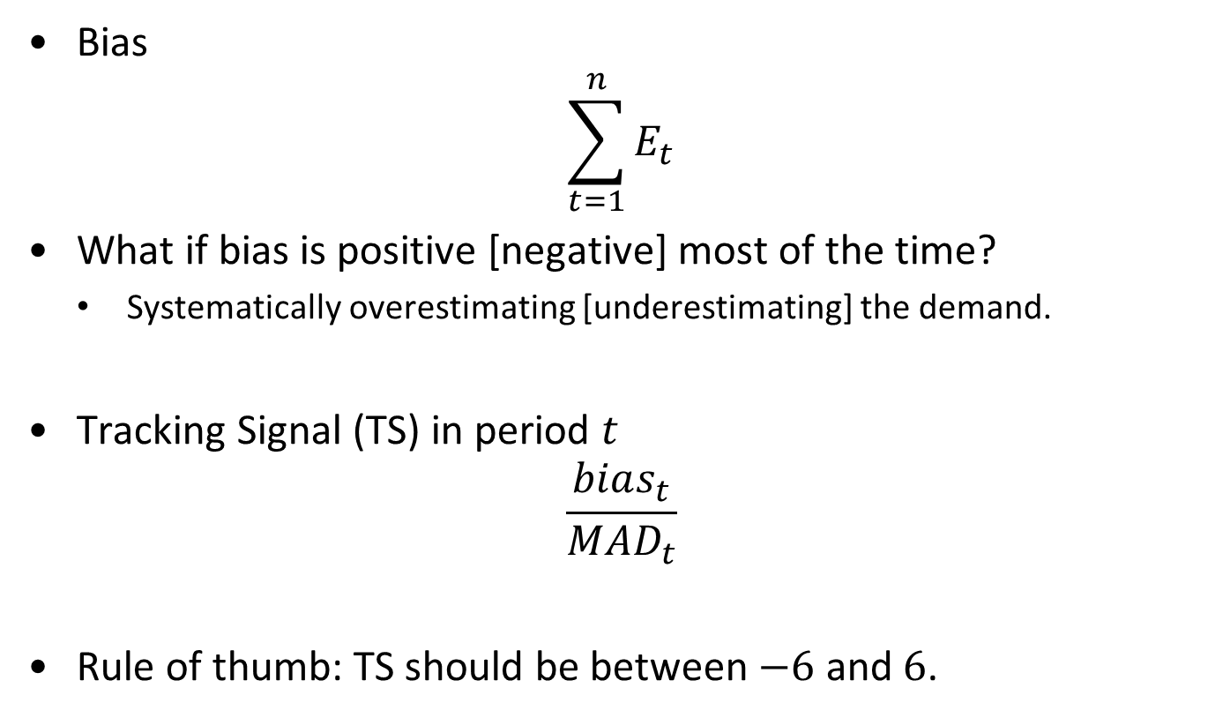
Measures of Forecast Error
Bias
$$\sum_{t=1}^{n}{E_{t}}$$
What if bias is positive [negative] most of the time?
Systematically overestimating [underestimating] the demand.
Tracking Signal (TS) in period $t$
$$\frac{bias_{t}}{MAD_{t}}$$
Rule of thumb: TS should be between $−6$ and $6$.

Slide 25
Measures of Forecast Error
Tracking signal is commonly plotted over time to see if there are changes in the underlying level of demand.

Slide 26
MSE vs MAD
Example MSE vs MAD
Calculate the bias and tracking signal for each period t
Time | Demand | Forecast 1 | Forecast 2
1 | 27 | 37 | 47
2 | 63 | 53 | 63
3 | 25 | 15 | 25
4 | 26 | 36 | 46

Slide 27
Validating a Forecasting Method
Book’s method:
Data Set
Make the forecast
Validate the forecast
Risk: overfitting, i.e., the forecast looks good because you are validating against the same data used to create it.

Slide 28
Validating a Forecasting Method
Our preferred method: Hold-out sample
Estimation Sample
Make the forecast
Hold Out Sample
Validate the forecast
Benefit: model does not “see” the hold-out sample, so it cannot be overfitting.

Slide 29
Validating a Forecasting Method
Book’s method checks whether a forecast model is descriptive: does the model fit well with the existing data?
Hold out method checks whether a forecast model is predictive: can the model be used to predict (i.e., forecast) the future?

Slide 30
Using a Hold Out Sample
Use only first part of the data (training set) to construct the forecast.
Use the last part of the data (hold out sample or validation set) to update and compute error terms. The part of the data we don’t use to construct the forecast is “held out” for validation.
How do we choose the size of the hold out sample?
When the estimation sample is larger,
When the hold out sample is larger,
Rules of thumb:
Use at least half the data to estimate.
If the data has seasonality, make sure hold out sample has at least one observation from each season.

Slide 31
Using StatTools to validate a forecast
Forecast tool:
Holdout size = number of observations you want to hold out.
StatTools calculates error separately for training set and hold out.
Note: StatTools calculates
The MAD (called Mean Abs Err).
The square root of the MSE (called Root Mean Sq Err). You need to square this to get the MSE.
The MAPE (called Mean Abs Per% Err).
StatTools also calculates the raw error for each forecast, so you can easily calculate Bias and TS.

Slide 32
Choosing the smoothing constant
The smoothing constant(s) can be chosen to minimize MSE, MAPE, MAD.
In the absence of a preference, minimize MSE.
Rule of thumb: smoothing constants of >0.2 should only be used for a short period of time.
In StatTools, choose “Optimize Parameters” to select smoothing constants that minimize MSE.
Note: the forecast page in StatTools is “live”, so you can change the smoothing constants and watch it update.

Slide 33
Conclusions
Many companies offer sophisticated forecasting software, often under the name “demand planning.”
Things to be careful about:
Apply human intelligence.
Collaborate with supply chain partners.
Garbage in, garbage out.
Distinguish between sales versus demand.

